Slide 1
Offshore Wind In the UK
Mike Blanch

Slide 2
Agenda
DECC’s UK Renewables Service
Why the UK needs renewables
Why offshore wind is so important
The market
Maximising UK content

Slide 3

DECC’s UK Renewables Service
Trade promotion and supply chain development service to:
“support the growth of a world-scale UK renewable energy industry with increasing global market share, and capabilities sufficient to support the achievement of the UK’s 2020 renewable energy targets”

Slide 4
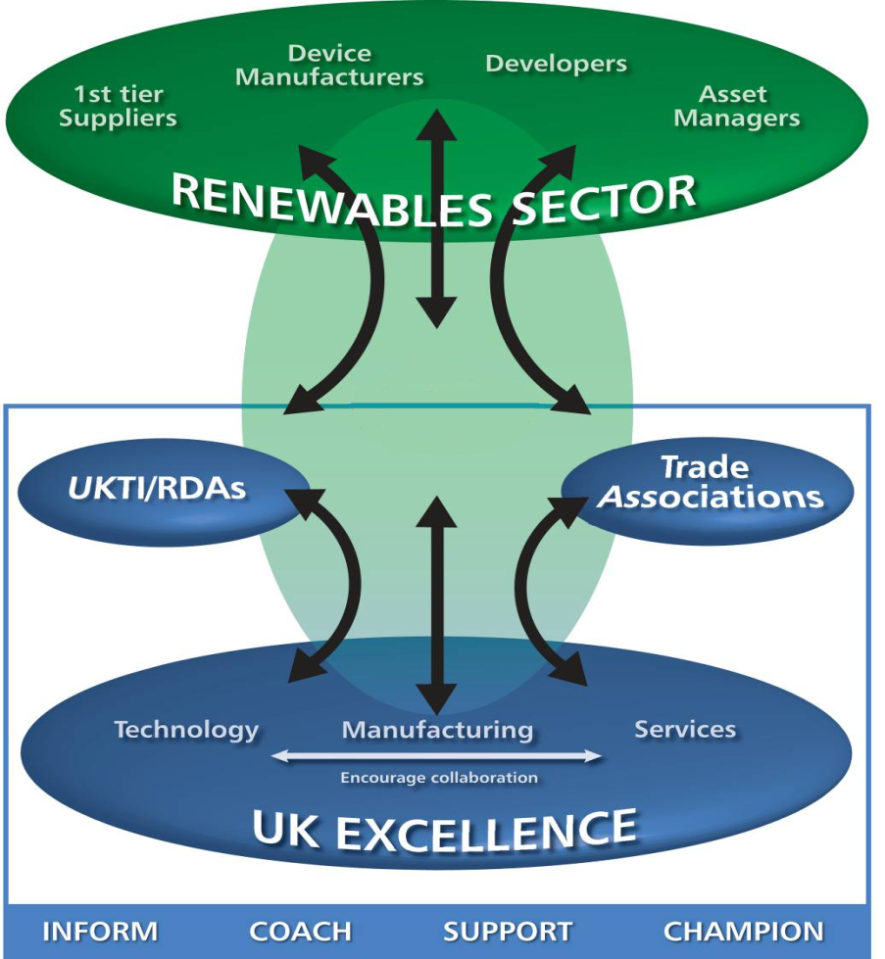
DECC’s UK Renewables Service
Inform, coach, support and champion UK businesses
Focus on excellence
Respond to requests :
  Wind industry
  Market entrants
  UK enabling bodies
Proactively create opportunities for UK:
  Supply & innovation
  Inward investment &
  joint ventures

Slide 5
T
Why Offshore Wind is so important to the UK
22
GW
Offshore wind
Onshore wind
Wave and tidal
Hydro
Solar
Other
Total
Offshore wind is the best placed technology to deliver 2020 electricity targets
Forecast UK 2020 electricity supply in 30% scenario

Slide 6
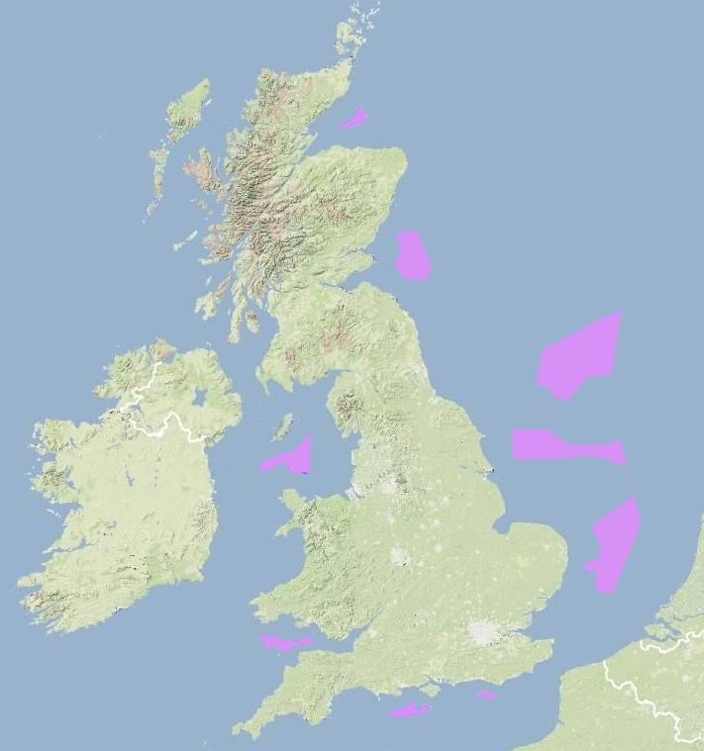
It is an achievable goal...
Already the world leader
  4.1GW operating
  (900MW+ offshore #1 globally)
  9.4GW consented
  (3.1GW offshore)
  2009 1st GW+ year
  By 2020 #2 in EU; offshore #1 globally
Best wind resource in the EU
Sustained and growing portfolio
Strong framework for development (DECC, Crown Estate, Ofgem, marine planning etc.)
Good history of consenting
Good history of delivering on time
Good history of Government commitment
Legend
Round 1 Offshore Wind Farm
Round 2 Offshore Wind Farm
Proposed sites in Scottish territorial waters
Potential Round 3
Development Zone

Slide 7
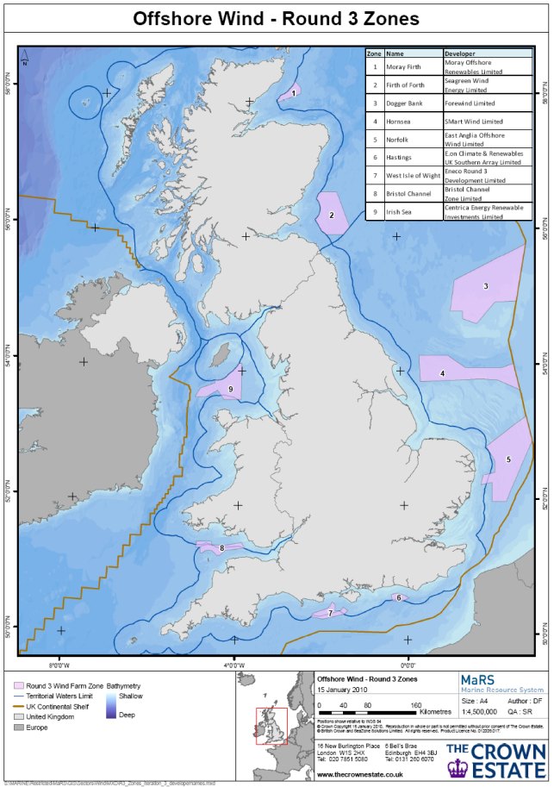
...but a huge challenge
Number of turbines to be installed
Water depth
Distance from shore
Capital Cost

Slide 8
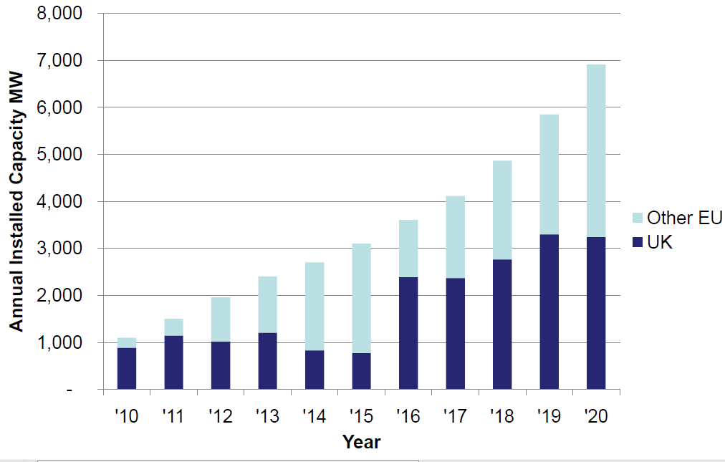
Expected UK Offshore Wind Installed Capacity
Notes:
We have combined our own latest, deeply informed forecasts of UK activity based on bottom-up data gathering with EWEA’s own forecast of activity to 2020 published in 2009.
Overall,we anticipate a UK market of approx.3.7GW in2020,

Slide 9
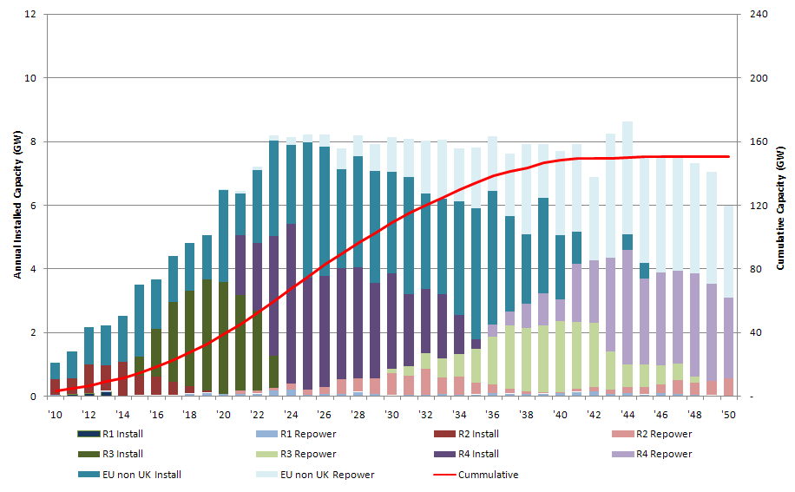
This is a long term commitment
Market is forecast to see long term activity allowing greater investment
Notes:
Forgive the pun but the Uk market is the place to get your feet wet, success in UK offshore wind will open the doors to new markets across Europe and the globe as they develop.
And don’t wait until round 3 construction begins in 2015, there are opportunities now in the earlier rounds.
Key message: 2020 is only the beginning this is a 30/40 year opportunity

Slide 10
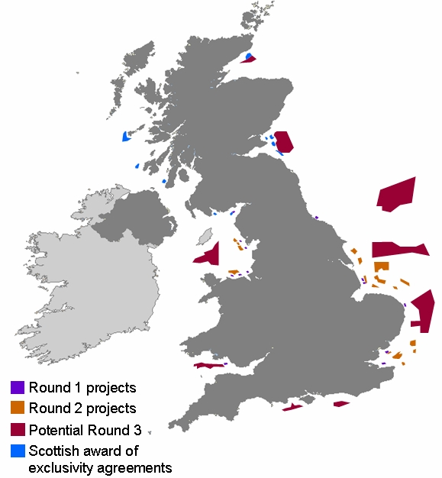
Addressing barriers to deployment
Effective & proactive
planning regime
Robust evidence bases for decisions
Provide market certainty
– e.g. SEA process
Addressing grid, radar & aviation issues
Notes:
Achieving our targets will be a challenge there are barriers but significant efforts continue to mitigate these issues and real progress is being made.
Planning: Put in place a single consents regime and the IPC an independent Infrastructure Planning Commission to provide the industry with a more predictable process with a decision within 12 months.
Market Certainty: For example our SEA decision in june 2009 enabled Crown Estate to proceed with the Round 3 leasing process which ahs brought us here today.
We continue to make progress on radar and aviation issues and a new regulatory regime for grid has been launched.
Message
Delivery will be more predictable

Slide 11
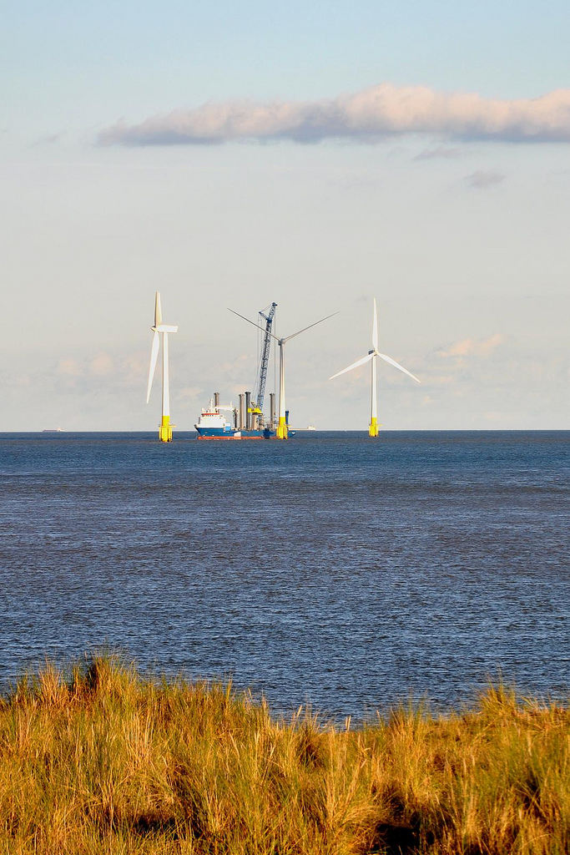
Maximising UK content
Meeting the UK offshore target will need an estimated £75 billion capital investment
Opportunity for generating UK economic benefit and green jobs
Recognised that skills and facilities aren’t in place at the moment so cooperation and engagement with Continent needed
Major goal is to build a substantial UK offshore wind supply chain
Notes:
As I have just said UK Gov is committed to achieving 15% of energy from renewable sources by 2020. For Electricity this means 30% from renewables. This will not be achieved without the necessary investment in offshore wind
Result
Offshore wind is a clear UK industrial policy – not just about hitting targets but generating economic benefit and green jobs in the UK.
Generates real opportunities throughout the supply chain
No reason why this should not happen in the UK
Key message; Meeting targets is also about generating economic benefit and green jobs in the UK

Slide 12


Maximising UK content
Meeting the UK offshore target will need an estimated £75 billion capital investment
Opportunity for generating UK economic benefit and green jobs
Recognised that skills and facilities aren’t in place at the moment so cooperation and engagement with Continent needed
Major goal is to build a substantial UK offshore wind supply chain
Notes:
As I have just said UK Gov is committed to achieving 15% of energy from renewable sources by 2020. For Electricity this means 30% from renewables. This will not be achieved without the necessary investment in offshore wind
Result
Offshore wind is a clear UK industrial policy – not just about hitting targets but generating economic benefit and green jobs in the UK.
Generates real opportunities throughout the supply chain
No reason why this should not happen in the UK
Key message; Meeting targets is also about generating economic benefit and green jobs in the UK

Slide 13
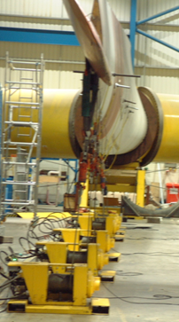
Backing words with action
UK has a built a world-class market
Now attracting world class industry leaders to base themselves here and government is leading this process
Has already allocated large multi-million grants to key manufacturers including Siemens, Vestas, Mitsubishi, Clipper, BiFab and TAG (Tees Alliance Group)
Building up world class testing and R&D facilities e.g. £30m supporting a drive train test rig in the North East
Carbon Trust’s Offshore Wind Accelerator programme which is developing innovations in foundations, access systems, wake effects and electrical systems
Notes:
The industry needs confidence to invest; developers, supply chain, finance community
We are doing this through the renewables obligation which we recently extended to 2037 and providing a level of banding that reflects the costs of individual renewable technologies
Key message: Government objective is to enable long term investment decisions to happen

Slide 14
UK Supply Chain Capability
The UK has hundreds of companies experienced in the wind industry.
The UK has the world largest offshore installation experience.
Some examples of UK capability:

Slide 15





UK Supply Chain Capability
The UK has hundreds of companies experienced in the wind industry.
The UK has the world largest offshore installation experience.
Some examples of UK capability:
In addition manufacturers that have located or stated public intention to locate in UK include...
...with many others considering the UK.

Slide 16








Innovation Support
DECC
  National Wind Turbine Test Centre
  Environmental Technology Fund (£30m+)
The Carbon Trust
  Offshore Wind Accelerator (£50m+)
Energy Technologies Institute
  3-4 wind turbine designs (£10m phase 1)
  Condition monitoring (£5m)

Slide 17




Innovation Support
The Crown Estate
  Supporting demonstration of new technology
Technology Strategy Board
  Regular public funding rounds in materials and
  other related areas
EPSRC
  Underpinning research
  Funding of doctorates etc.
Regional Funding
  Eg. Northern Way Innovation Programme

Slide 18

Innovation Support
The Crown Estate
  Supporting demonstration of new technology
Technology Strategy Board
  Regular public funding rounds in materials and
  other related areas
EPSRC
  Underpinning research
  Funding of doctorates etc.
Regional Funding
  Eg. Northern Way Innovation Programme

Slide 19
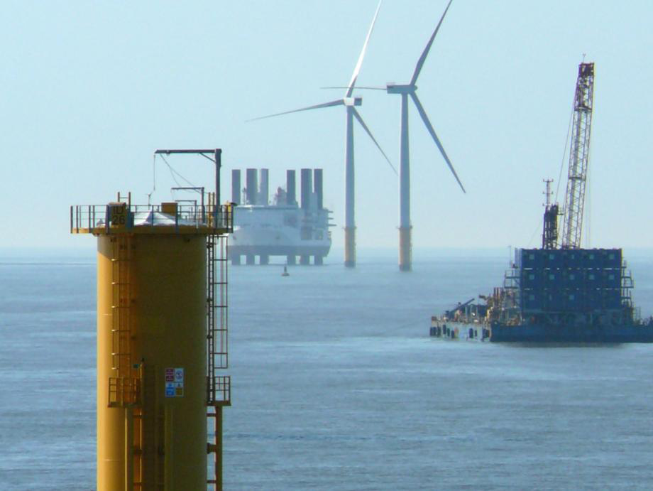
Why invest in the UK?
Best offshore wind market,
sustained long-term
#1 investment location in Europe
Strong, flexible labour market
(not experienced in wind turbine
technology)
One of most productive locations for
innovation
Global financial centre; international language
  Power sold in £ - buying in £ reduces exchange rate risk

Slide 20
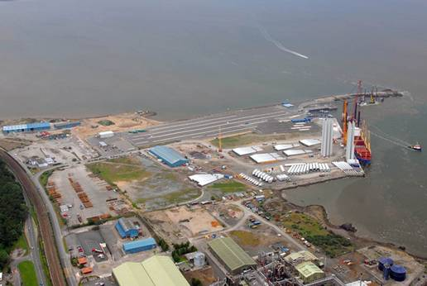



Doing Business in the UK
Easiest country in EU to do business in. Rated best for by
World Bank (2008):
  Starting a business
  Employing workers
  Registering Property
  Raising finance
  Protecting Investors
  Low taxes
  Competitive salaries
  Flexibility of workforce
More than 50% of European HQ’s in UK (Ernst & Young, 2008)
  Open and transparent system for foreign workers
  Stable economic and political environment
  Sound legal and regulatory environment
  Good international transport links and communications infrastructure
  Strong access to talent (38,620 engineering graduates per year) HESA, 2007
  Globally recognised innovators and business leaders

Slide 21
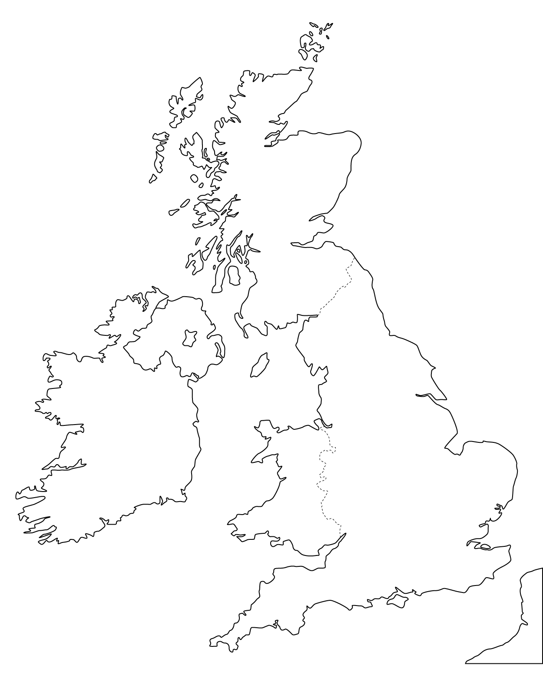





Supply Chain Enablers – National

Slide 22













Supply Chain Enablers – Regional

Slide 23
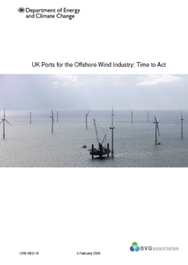
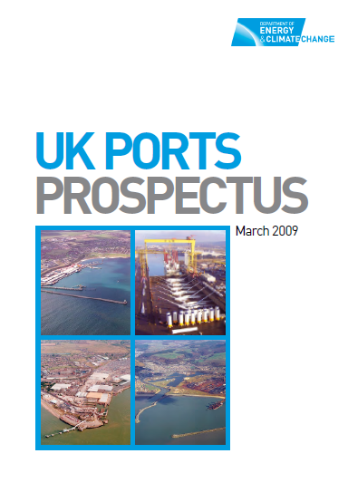
UK Ports
  Sites available
  Understanding growing
  Dialogue deep
  Industry focussing on
  East Coast
UK Ports Prospectus

Slide 24
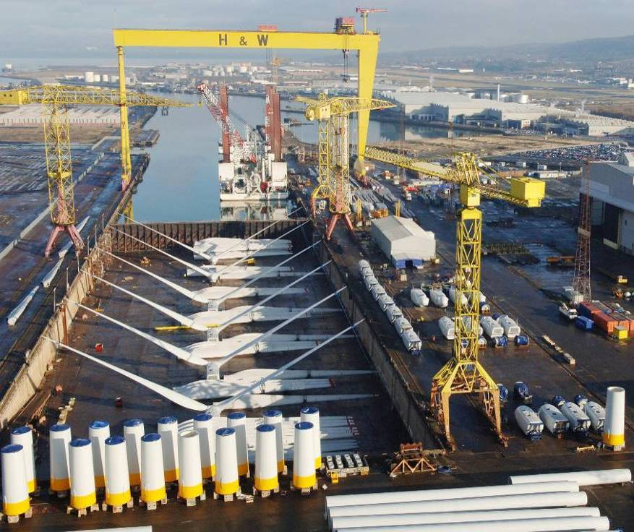
DECC’s UK Renewables Service – here to help
We can connect you to UK:
  Ports
  Suppliers
  Innovators
  JV collaborators
  Funders / enablers
  Customers
We will work with you to:
  Explain how UK works
  Smooth your journey
  Help you collaborate
  with UK

Slide 25
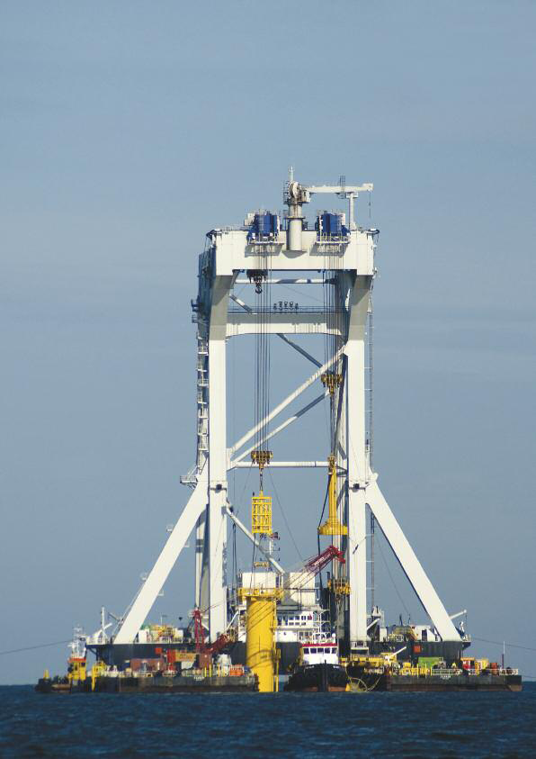
Summary
UK is leading in offshore wind
UK wants economic benefit not just to meet targets
UK wants to collaborate more to deliver
DECC’s UK Renewables Service is here to help make it happen

Slide 26
Thank You
Mike Blanch
mike.blanch@ukrenewables.com
0044 (0)1793 799020
www.ukrenewables.com
DECC’s UK Renewables Service

